Slide 1
Exploring Solutions to the N-Queens Problem
Aaron Paul & Chem Chikweze

Slide 2
Introduction
The N-Queens problem involves placing N queens on an N×N chessboard so that no two queens threaten each other.
Objective: Explore various computational methods to solve the problem efficiently.

Slide 3
Computational Approaches Used
• Sequential Approach: Single-threaded traditional method.
• Parallel with pthreads: Parallel computing on a single machine using multiple threads.
• Distributed with MPI: Utilizing multiple computers to distribute the computation.
• Work-Stealing Queue Model: Advanced thread management for optimized computation.

Slide 4
Overview of Solutions
Key components include safe placement checks and recursive solution finding using C++, Bash, pthreads, and MPI. Challenges addressed include synchronization and data distribution.

Slide 5
Performance and Outcomes
Execution times and number of solutions for various board sizes were compared. Parallel and distributed methods showed improved performance and scalability.
Placeholderfor sequential run image
Placeholder for distributed run image
Placeholder for work_stealing run image

Slide 6
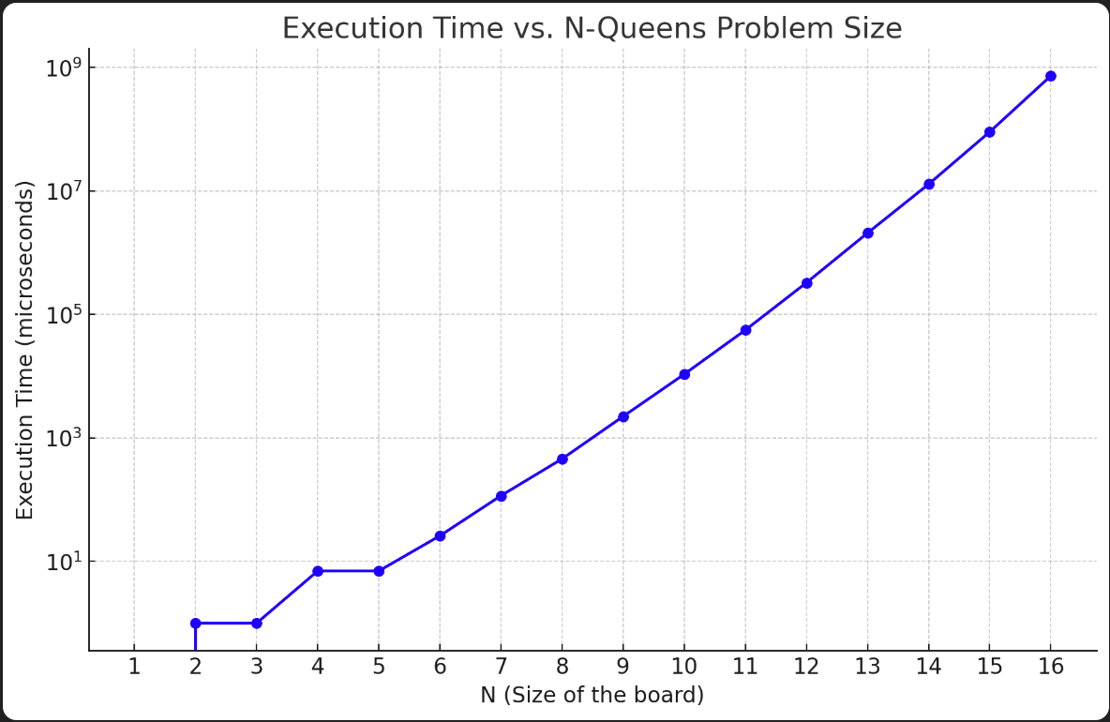
Sequential Solution

Slide 7
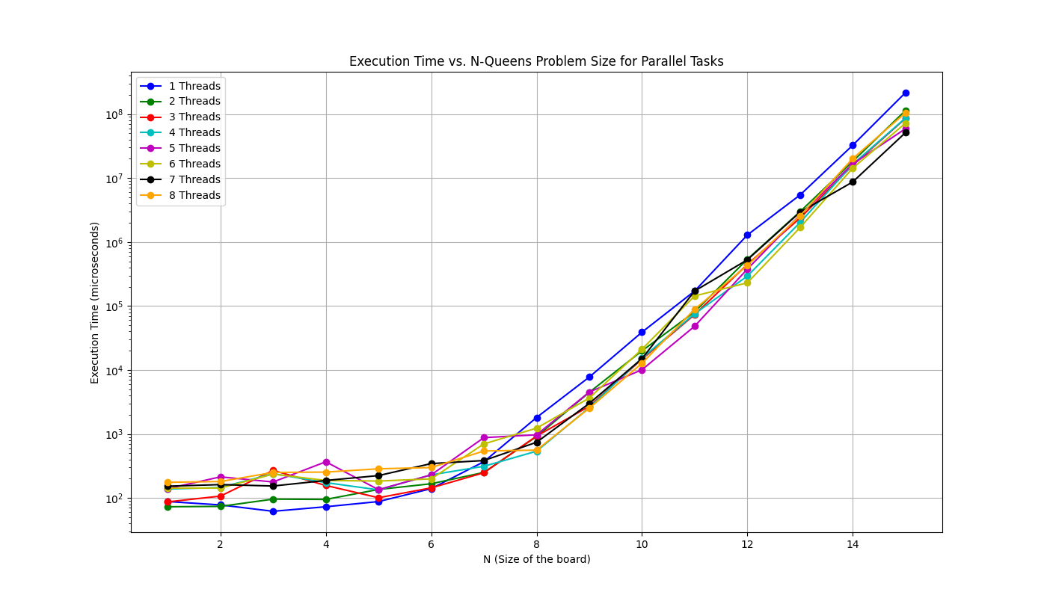
Parallel Tasks
.

Slide 8
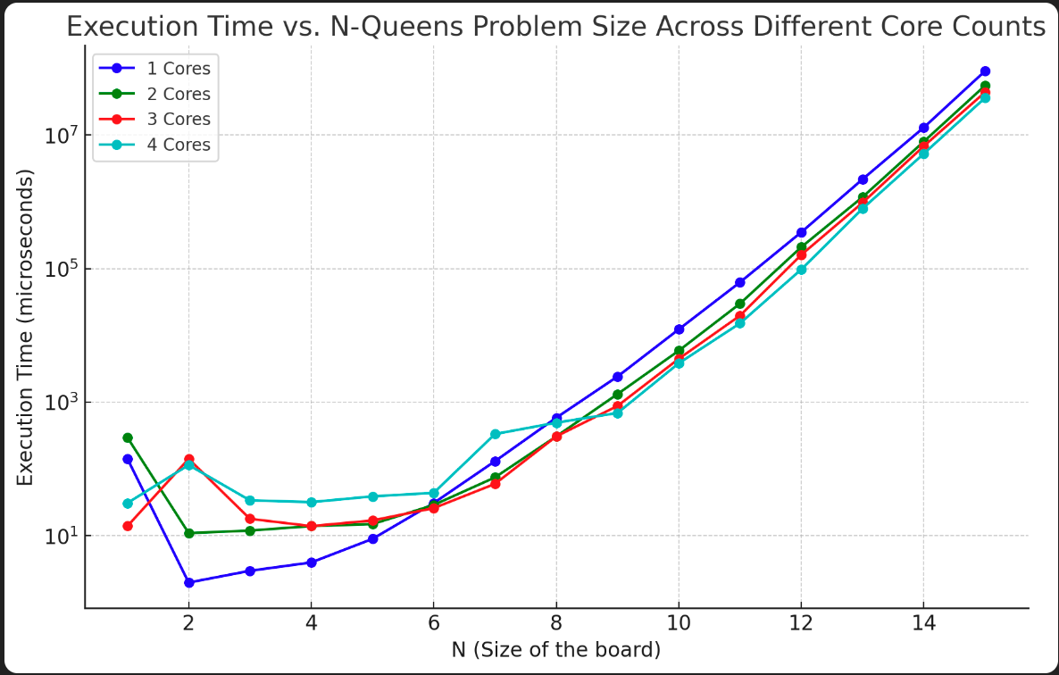
Multi Core Solution

Slide 9
Conclusion and Future Work
Each approach has its strengths and can be further optimized. Future work could explore hybrid approaches and further optimize thread management.

Slide 10
Thank You and Q&A
Thank you for your attention!

